Slide 1
Operating System

Slide 2
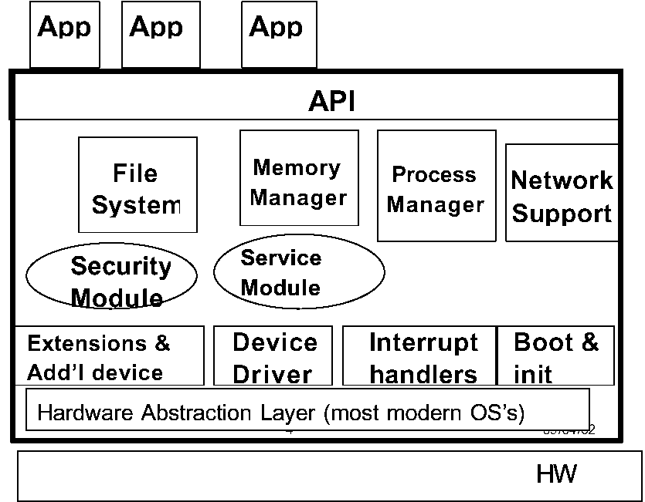
1. Monolithic Kernel

Slide 3
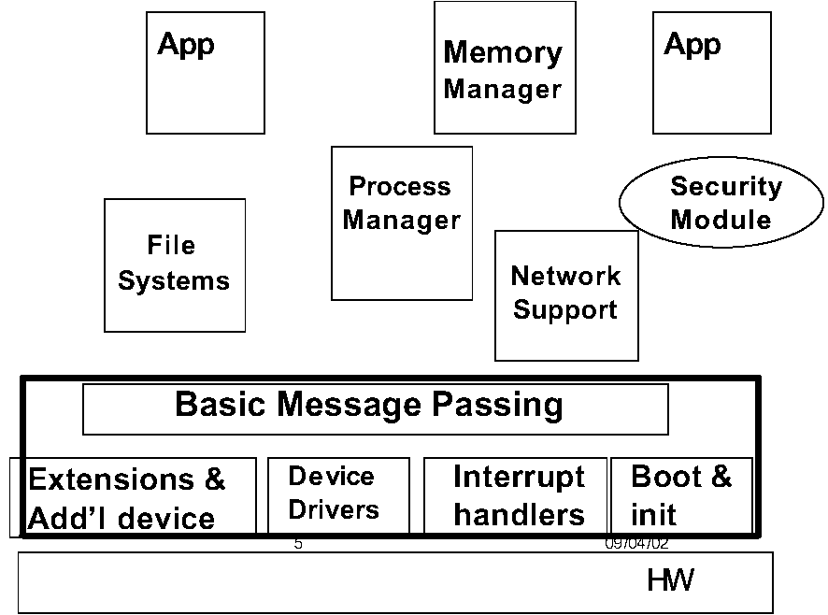
Microkernel

Slide 4
Process
Variables point to instructions + data
Loaded in memory
context contains all process state info.
stored in Process Control Block
One user and one program per process
Also called task
(or job for batch processes)

Slide 5
Process Context
program counter
register indicating next program instruction to run
other registers
accumulator, index/address, status, general
stack of subroutine return addresses
subroutines call other subroutines
values of local and global variables
pointers to open data files
user and terminal number (in multi-user OS)

Slide 6
Examples of Processes
User Processes
Shells
Text editors, databases
Background jobs (end with & in UNIX)
System Processes
Memory management, process scheduling
daemons (system background processes)
Mail and print servers

Slide 7
Thread
Also called sub- or lightweight process
Little private memory; memory is shared
Subdivides work of the process
Threads are managed by the process
Reduces high overhead for creating processes and context switching
Java was designed to write thread-based programs

Slide 8
Thread Components
At minimum, every thread has its own
program counter
stack
Program text shared with other threads
Each procedure has a frame to hold its local variables
Heap of objects is shared by all threads

Slide 9
Uses of Threads
Servers (database, mail, print, etc.)
one thread per client request
Network server
one thread per connection
Time-sharing
one thread per user
Real-time factory control
one thread per device

Slide 10
Context Switching
Preserve state of current process
Start or re-start another process
Performed by dispatcher (OS component)
When to change context?
Overhead cost (takes CPU time)
Processes prioritised by properties

Slide 11
4. Process States
Runnable
Running (only one per processor)
Ready (waiting for its turn to run)
Blocked
Explicit e.g. wait() until a child terminates
Implicit e.g. read()
Blocked by another process
New (not yet allowed to wait its turn)
Suspended (e.g. swapped to virtual memory)
Terminated (finished but still using resources)

Slide 12
Process State Diagram Ritchie p. 62
entry (HLS)
I/O completion
ready
(LLS) dispatch
blocked
timeout
I/O wait
(MLS) suspend
running
resume
suspend
resume
suspend
termination
ready suspended
blocked suspended
I/O completion

Slide 13
5. Scheduling
Assign each process time to use CPU
Determine sequence (order), timing (when)
Conflicting objectives → need compromise
Scheduling levels
High: whether to admit a new process
Medium: suspend/resume a process
Low: dispatch (run) a ready process

Slide 14
Scheduling Objectives
Maximise throughput
Give all users a “fair” (not equal) chance
Provide tolerable performance
Response time for on-line user
Turnaround time for batch users
Degrade performance gracefully
OK to be slow but avoid complete collapse
Be consistent, predictable over time

Slide 15
Scheduling Criteria
Priority which may be either/both:
Assigned to job by user
Determined by properties of the job
Class of job (real-time > on-line > batch)
Resources needed (CPU time, memory)
I/O or CPU bound (the aim is a balance)
Resources already used
Time already waited

Slide 16
Types of Scheduling Policies
Preemptive (Used by most OS today)
OS stops one process to run another
Non-preemptive
process runs until termination or I/O wait
Cooperative (Used by Windows 3.11)
Programs must voluntarily give up CPU
Not managed by OS; trusts programmers
If a process hangs the whole PC hangs ☹

Slide 17
Scheduling Policies
First come first served (FCFS/FIFO)
Shortest job first (SJF)
Shortest remaining time (SRT)
Highest response ratio next
Round robin (RR)
Multi-level feedback queues (MFQ)

